Slide 1
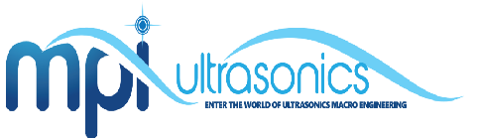
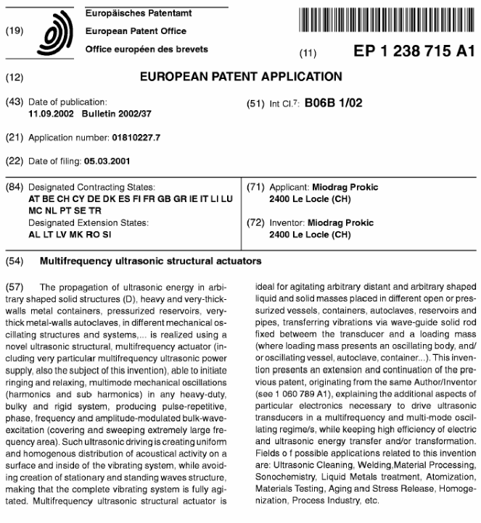

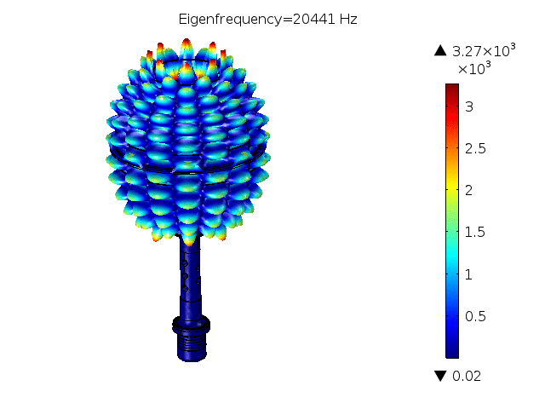
Agitating big masses and tubes in refineries
-- Ultrasonic Stress Relief --
Miodrag Prokic
Marais 36,
2400 Le Locle
Switzerland
mpi@mpi-ultrasonics.com
www.UltrasonicsWorldGroup.com
Phone: +41-32-9314045
Fax: +41-32-9314079

Slide 2

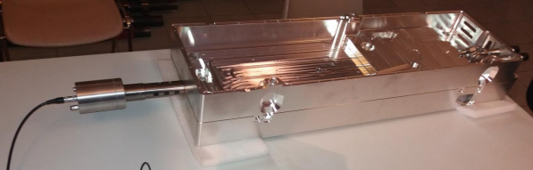
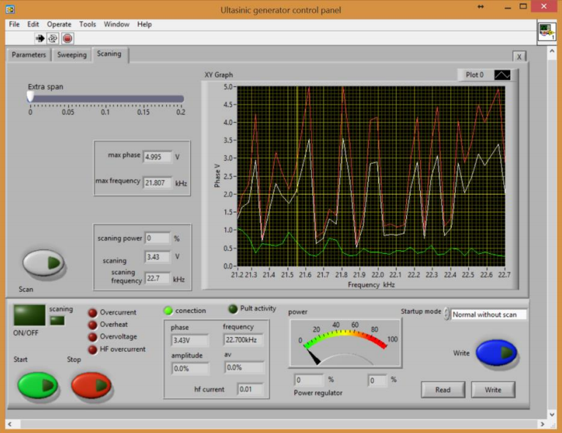
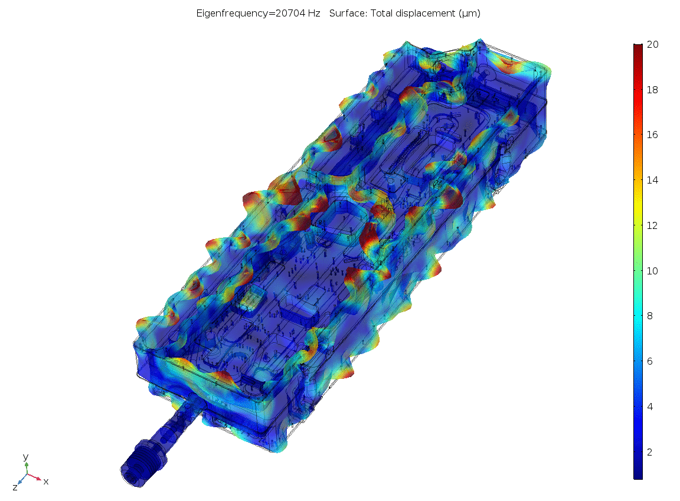
MMM technology has applications in ultrasonic treatment of high-tech parts, sensitive and complex metal parts, treating of biological implants, surgery and many other fields.
Fast stress relied
Fatigue life extension
Accelerated aging and material-properties stabilization
Ability to treat components too large for any oven
Real-time cleaning of deposits and scaling
Al part

Slide 3
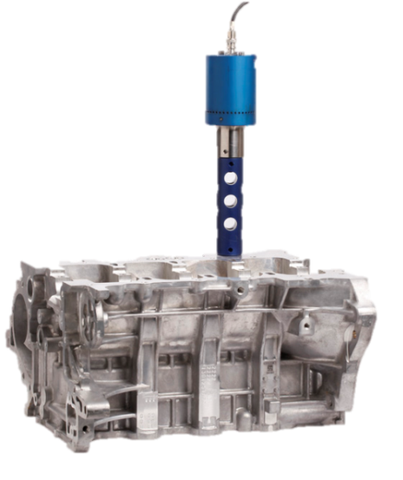
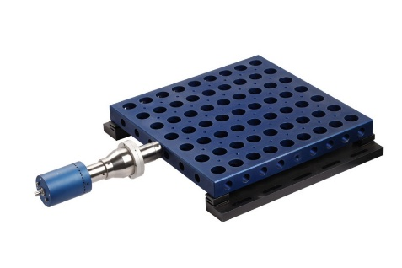
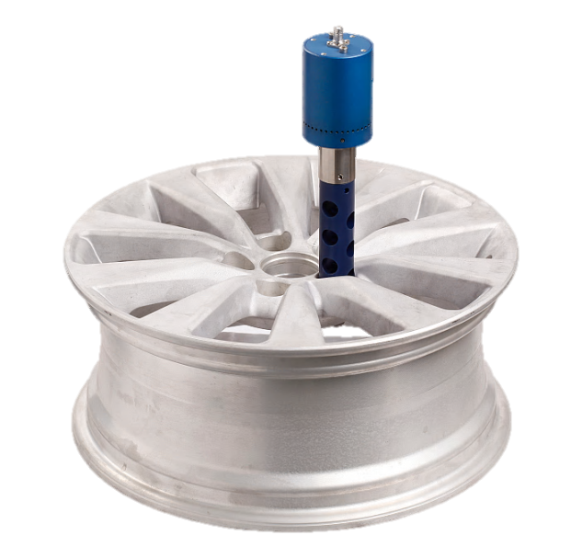
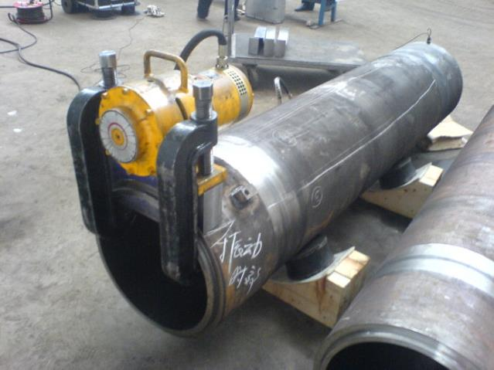
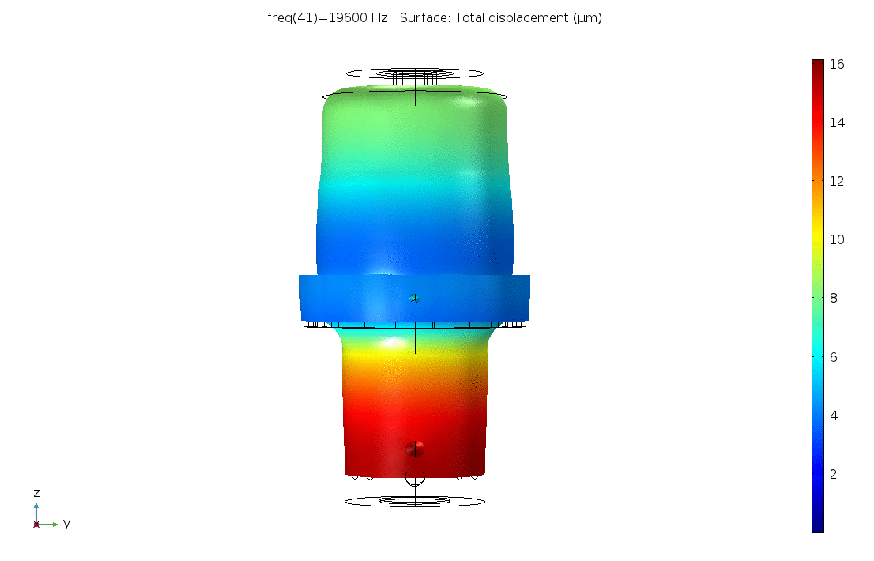
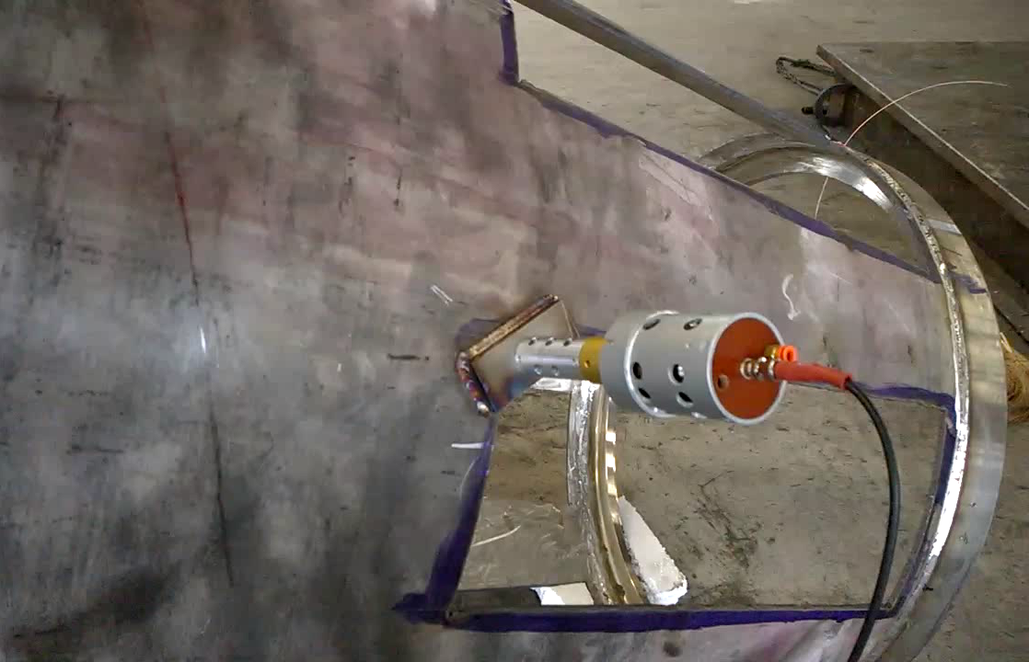
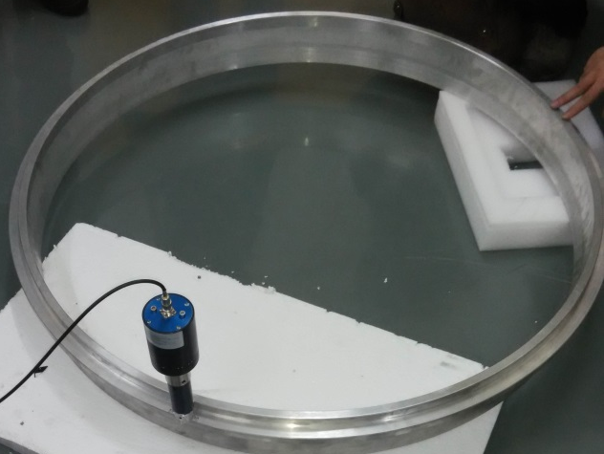
VS
Transdutor 20 kHz
MMM: Multi-frequency, Multimode, Modulated ultrasonic agitation.

Slide 4
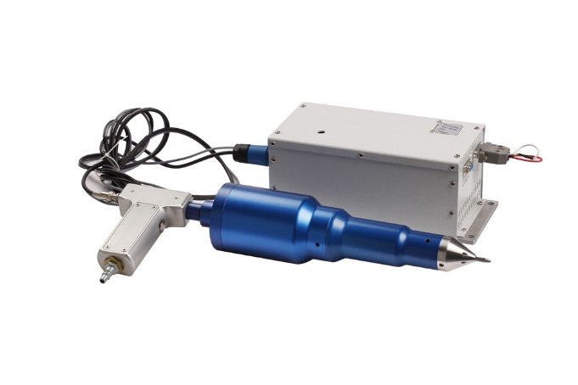
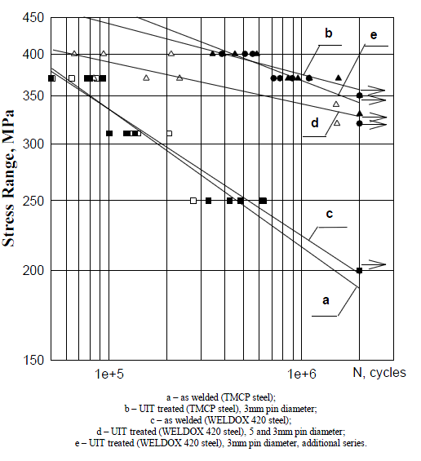
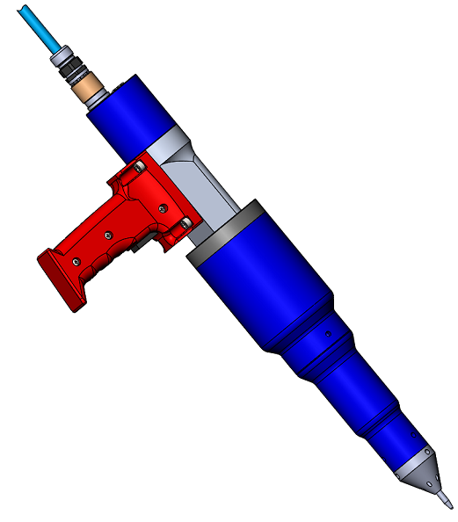
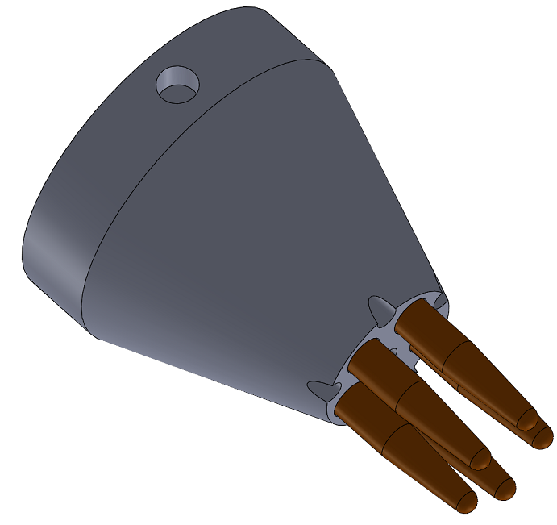
MMM Ultrasonic technology can revolutionize the metal industry !
Stress Measurement
Ultrasonic Peening Technology
Ultrasonic Peening Solution
Stress Measurement
Can be applied different tools!
MMM: Multi-frequency, Multimode, Modulated ultrasonic agitation.

Slide 5
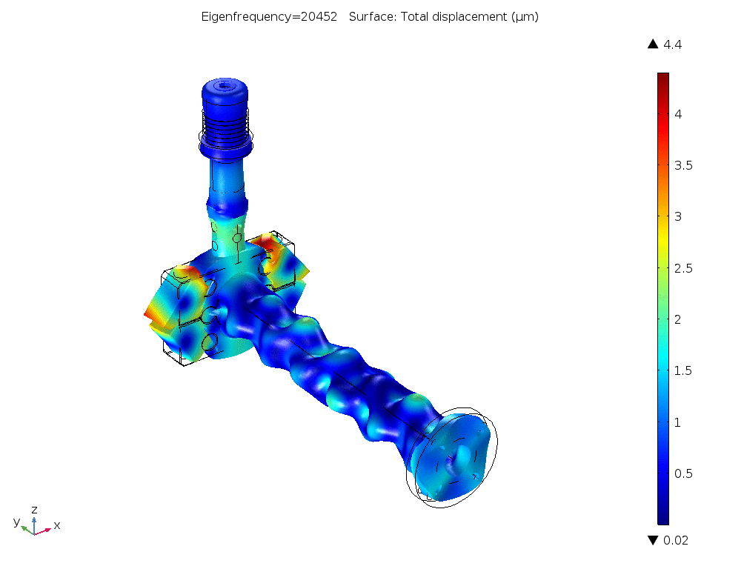
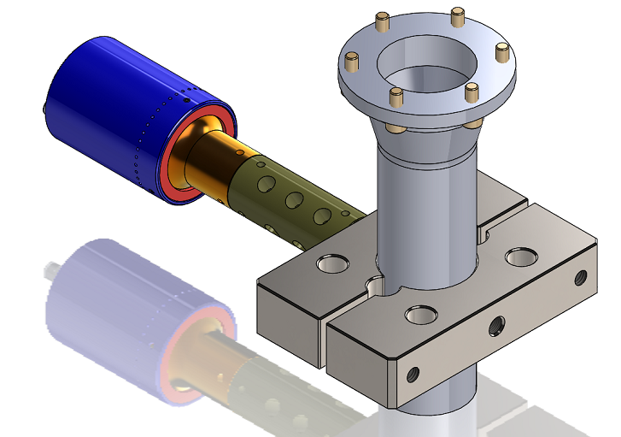
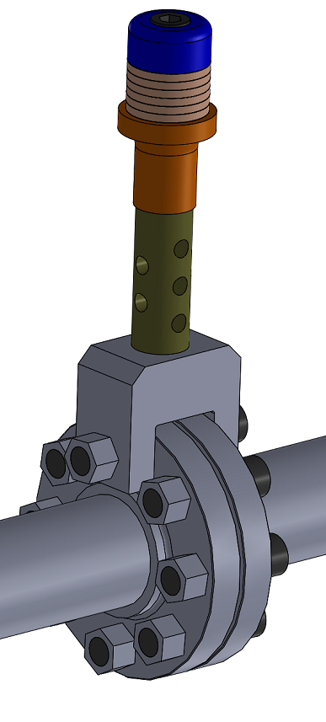
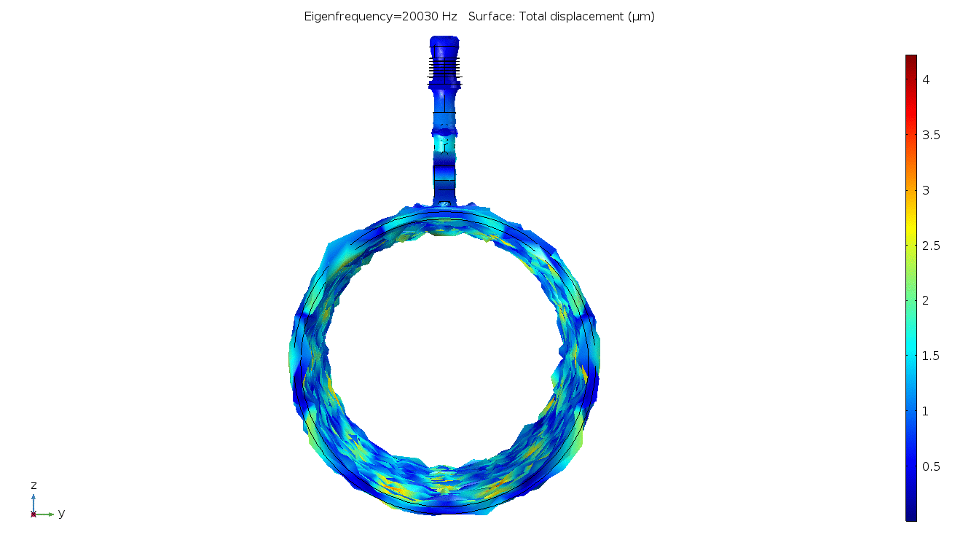
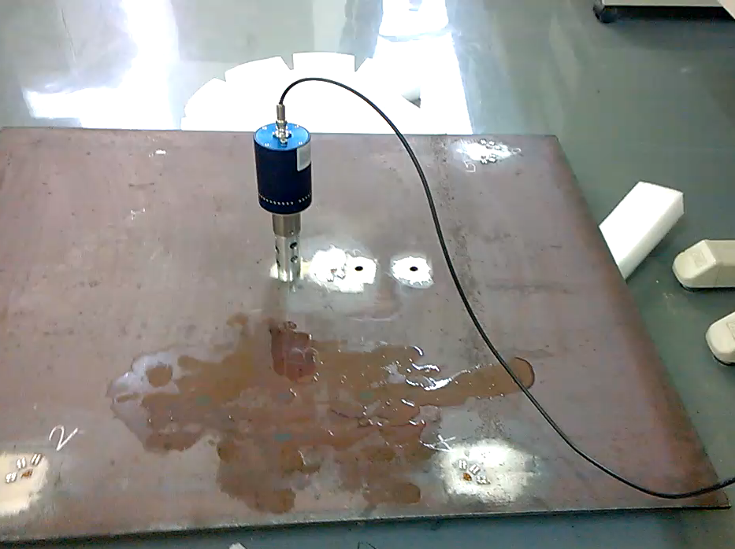
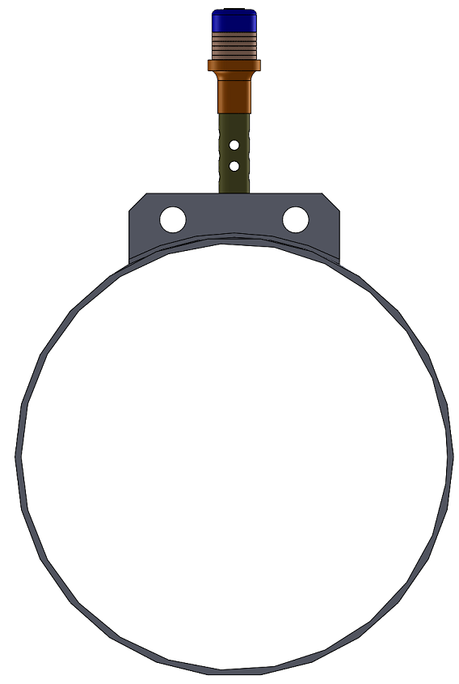
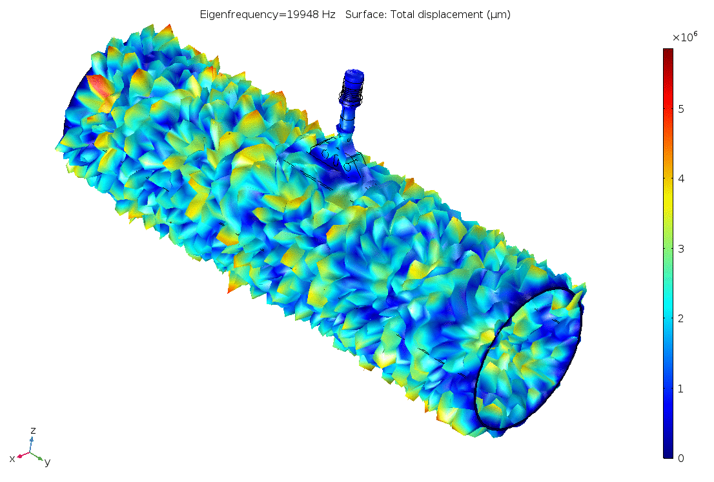
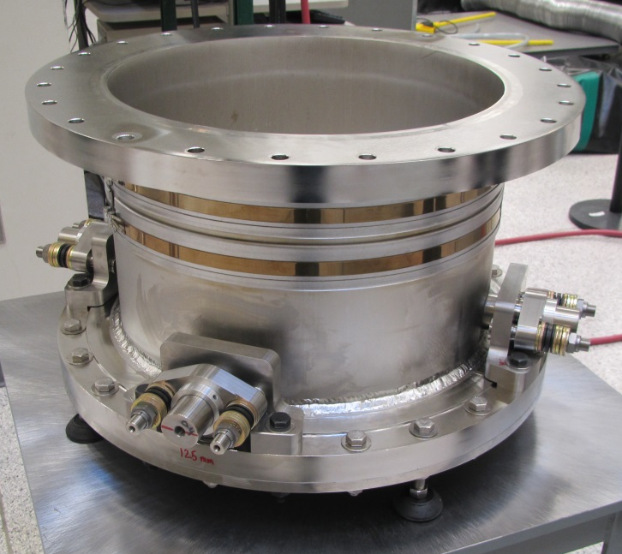
Connector for big parts!
D=500mm
MMM: Multi-frequency, Multimode, Modulated ultrasonic agitation.

Slide 6
For more information
Visit
https://www.mpi-ultrasonics.com
your future is our present!

